Slide 1
ACGME DEI Guidelines – Practical Information
Gloria J. Guzmán Pérez-Carrillo, M.D., M.Sc., M.P.H.
Assistant Professor of Radiology, Neuroradiology Section
Diversity Office, Assistant Director Office of Faculty Affairs
Co-Director, Advanced NeuroImaging Service

Slide 2
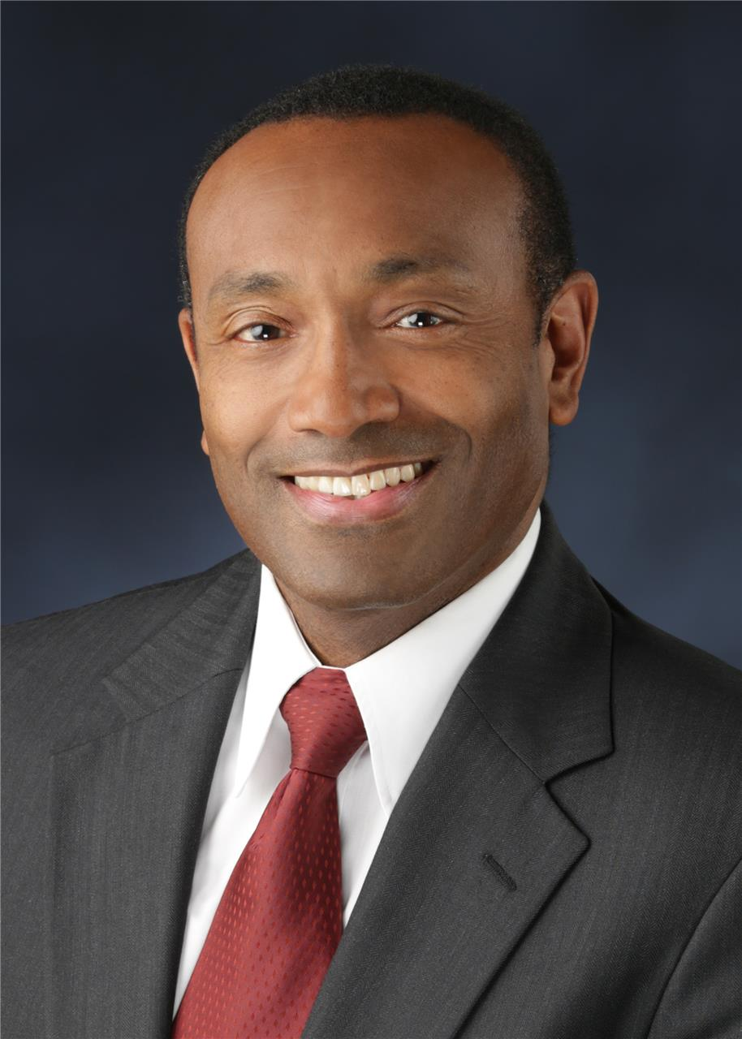
Source of Information
Oral communication with Dr. William McDade, MD, PhD, ACGME’s Chief DEI Officer
Contact: William A. McDade, MD, PhD, Accreditation Council for Graduate Medical Education, 401 N Michigan Avenue, Suite 2000, Chicago, IL 60611, 312.755.5000, wmcdade@acgme.org
https://www.globenewswire.com/news-release/2019/03/11/1751337/0/en/ACGME-Names-First-Chief-Diversity-and-Inclusion-Officer.html

Slide 3
NO FORMAL CURRICULAR REQUIREMENTS FOR RADIOLOGY

Slide 4
Workforce and learning environment requirements
Keep records of demographics of both trainees and interviewees
Proof of short and long-term strategies to diversify workforce

Slide 5
Short-term strategies
Proof of programming to provide acclimation to the local patient population
Implementation of implicit bias training (i.e. Harvard IAT test)
Ally training- ACGME modules TBD

Slide 6
Short-term strategies
Second-look visits for URiM
DEI signage
Awards for DEI work
Book club / article club around DEI topics

Slide 7
Short-term strategies
Mentoring programs for URiM trainees
Link to local College of Medicine (COM) URiM clubs/programs
Holistic recruitment process

Slide 8
Long-term strategies
Community outreach programs to disadvantaged high schools and URiM college students (i.e. Pre-med STEM programs)
Summer research programs targeted to women and URiM

Slide 9
Long-term strategies
Creation of radiology-specific DEI Officer / Office
Visiting URiM and women radiology sub-I

Slide 10
Helpful, but not directly managed by ACGME
Faculty retention and recruitment programs for URiM either within the radiology department or the COM
DEI climate assessments in place
Active collaboration with local DEI experts, i.e. COM Diversity Dean
Creation of Diversity Vice Dean at the GME office level

Slide 11
References
Harvard Implicit Bias Test: https://implicit.harvard.edu/implicit/takeatest.html
ACGME DEI website: https://www.acgme.org/Newsroom/Newsroom-Filtered/pfcatid/173/Diversity
Racial Equity Institute: https://www.racialequityinstitute.com/
Seeing white podcast series: https://www.sceneonradio.org/seeing-white/
Book, How to be an Antiracist: https://www.amazon.com/How-Be-Antiracist-Ibram-Kendi/dp/0525509283
Book, Blindspot- Hidden Biases in Good People: https://www.amazon.com/Blindspot-Hidden-Biases-Good-People/dp/0345528433/ref=sr_1_1?keywords=blindspot&qid=1584298690&s=books&sr=1-1

Slide 12
Extra - Suggested references from Dr. McDade’s presentation
Book- Unequal Treatment: Confronting Racial and Ethnic Disparities in Health Care
Saha S, Guiton G, Wimmers PF, Wilkerson L. Student body racial and ethnic composition and diversity-related outcomes in US medical schools. Jama. 2008 Sep 10;300(10):1135-45.
Liebschutz JM, Darko GO, Finley EP, Cawse JM, Bharel M, Orlander JD. In the minority: black physicians in residency and their experiences. Journal of the National Medical Association. 2006 Sep;98(9):1441.
Dyrbye LN, Thomas MR, Eacker A, Harper W, Massie FS, Power DV, Huschka M, Novotny PJ, Sloan JA, Shanafelt TD. Race, ethnicity, and medical student well-being in the United States. Archives of Internal Medicine. 2007 Oct 22;167(19):2103-9.

